Slide 1
Ensemble Learning

Slide 2
Topics
Wisdom of the crowd
Voting Classifier
Hard voting vs Soft voting
Bagging and Pasting
Random Subspaces and Random Patches
Random Forests
Feature importance
Adaptive Boosting
Gradient Boosting
Shrinkage
Stacking

Slide 3

Wisdom of the crowd
Suppose we pose a question to thousands of random people
in many cases, we find that the aggregated answer is better than an expert’s answer
Law of large numbers
suppose we try our best to train a model and the best we get is 51% accuracy
if we could duplicate it into 1k models, then aggregate their individual answers, the majority would be correct 73% of the time
with 10k of these models, the answer would be correct 97% of the time
probability of getting a majority of good answers increases with the number of models
Similarly, if we aggregate the predictions of a group of predictors: we often get better predictions than with the best individual predictor
a group of predictors is called an ensemble
the technique Ensemble Learning
This is true if all classifiers are perfectly independent
making uncorrelated errors

Slide 4
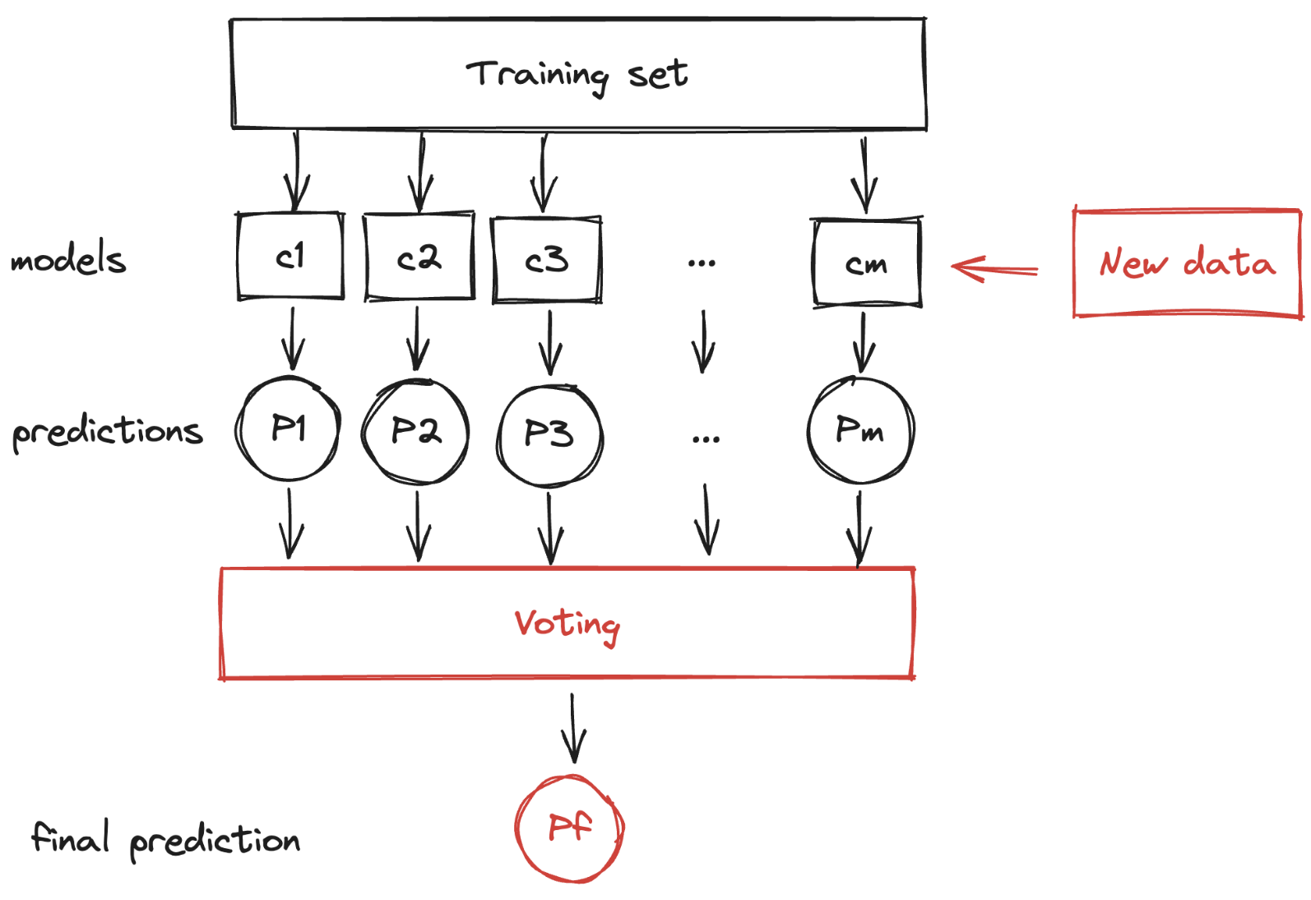
Voting Classifier
We can train a group of classifiers
on a different random subset of the training set or using different algorithms
we obtain the predictions of all the individual model
then predict the class that gets the most votes

Slide 5
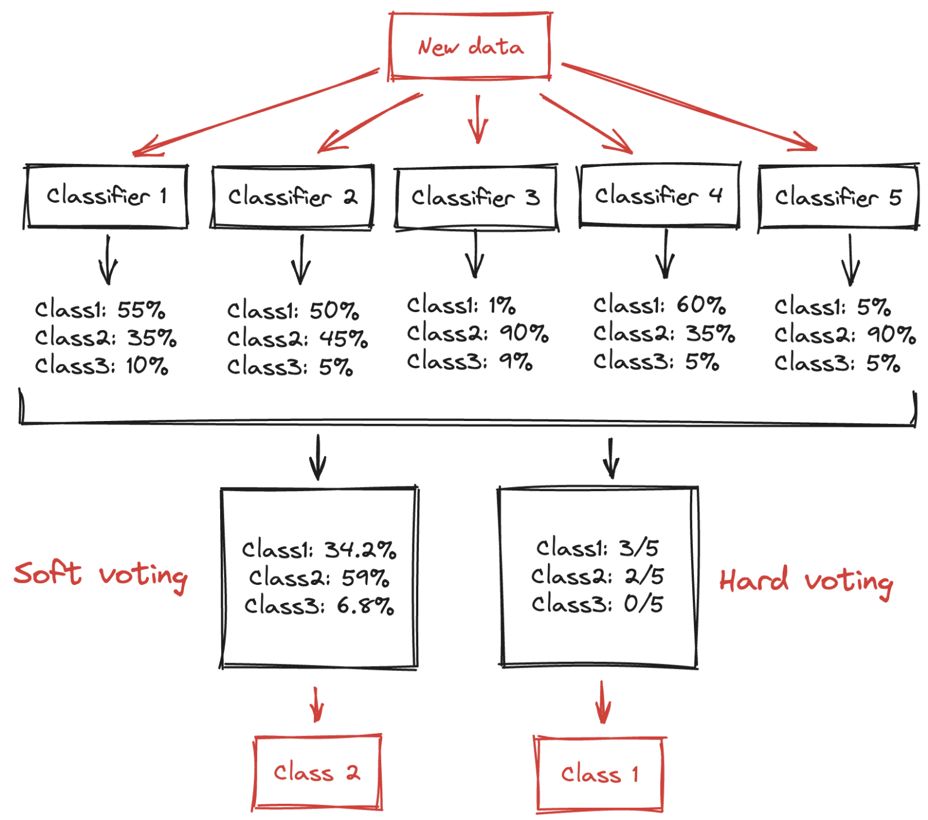
Hard voting vs Soft voting
If all classifiers can estimate class probabilities, then we can predict the class with the highest-class probability, averaged over all the individual classifiers

Slide 6
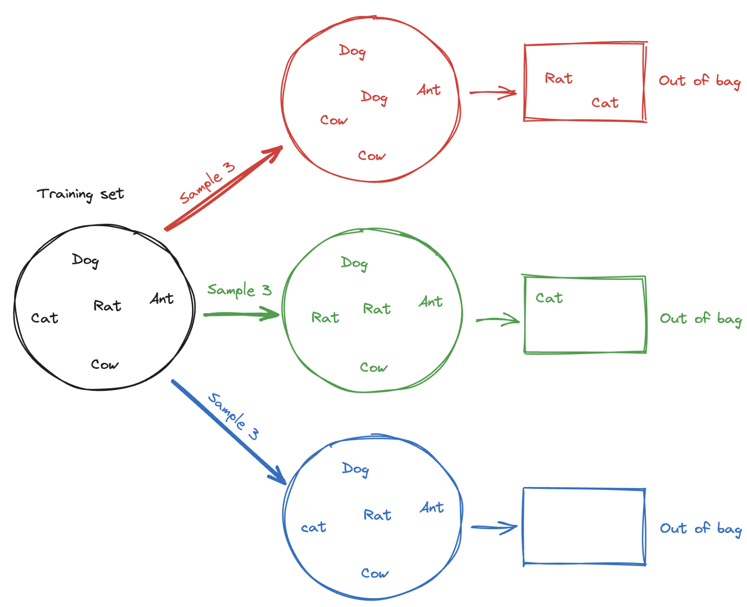
Bagging and Pasting
To get a diverse set of classifiers we can use the same training algorithm for every predictor but train them on different random subsets of the training set
How can we generate the subsets?
pasting repeatedly drawn, samples from data to form other smaller datasets
bagging repeatedly drawn but with replacement (bootstrapping)
Using bagging, there’s a chance that a sample would never be selected, while another may be selected multiple time
out-og-bag
a predictor never sees the out-of-bag instances during training, it can be evaluated on these instances, without the need for a separate validation set

Slide 7
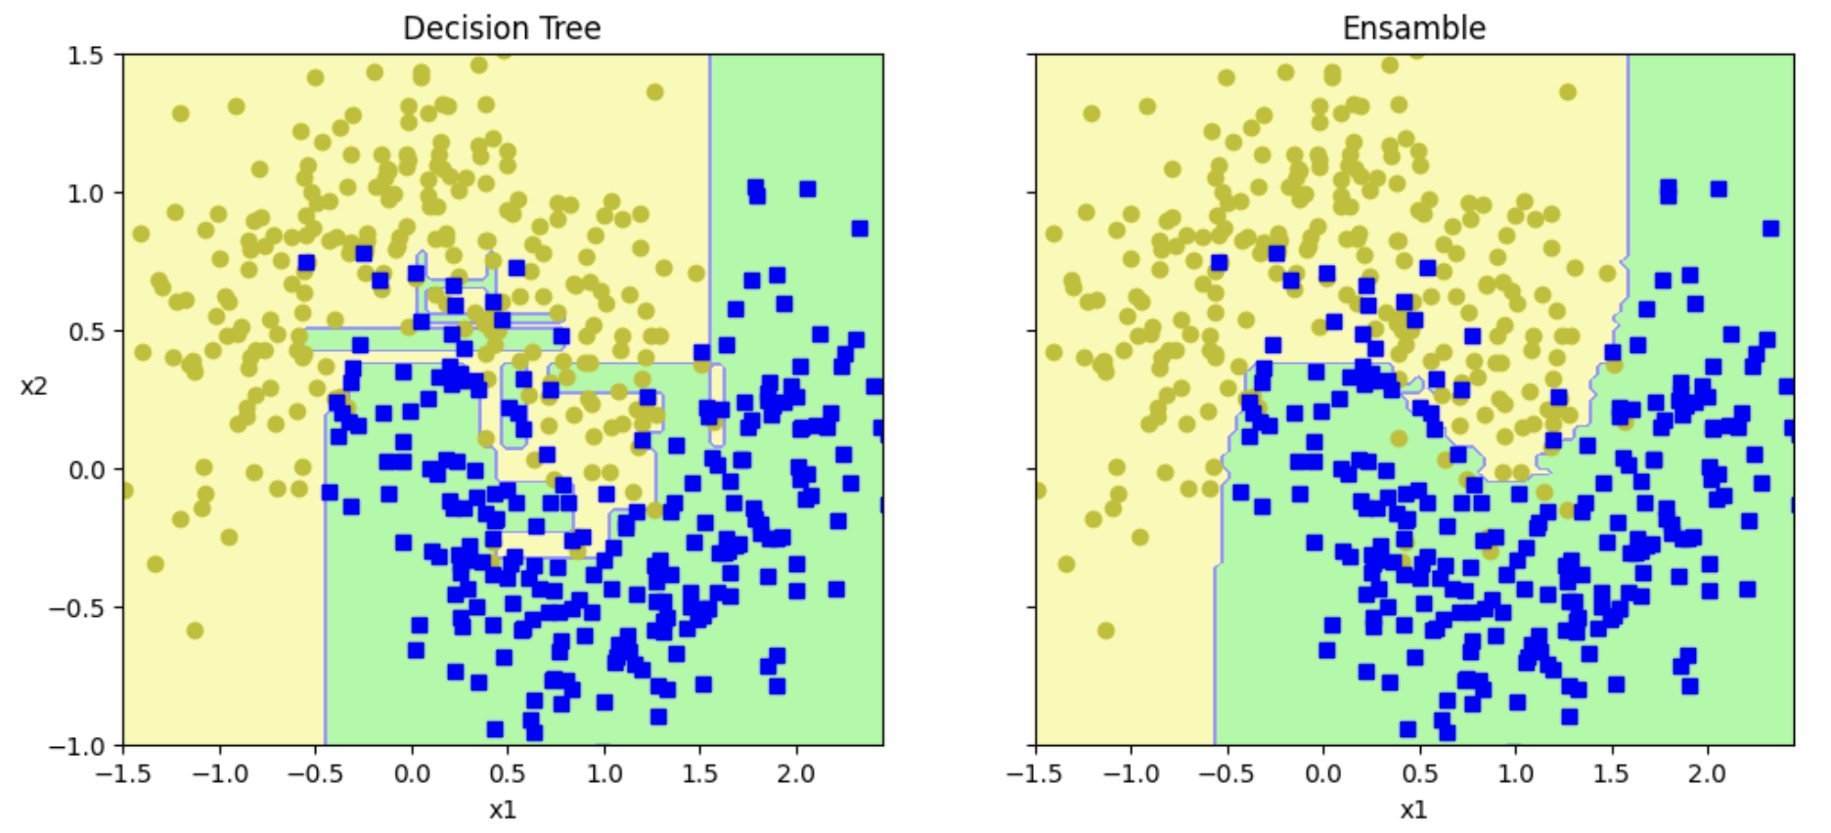
Random Subspaces and Random Patches
We can sample the features as well
each predictor will be trained on a random subset of the input features
useful when we are dealing with high-dimensional inputs (such as images)
results in even more predictor diversity, trading a bit more bias for a lower variance
Random Subspaces method
Sampling both training instances and features is called the Random Patches
Example on the moons dataset of a single decision tree and an ensemble

Slide 8
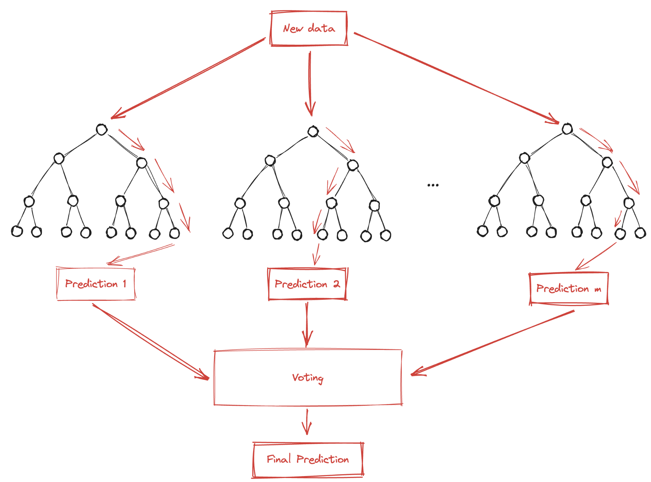
Random Forests (1)
An ensemble of decision trees, trained via the bagging method, typically with max samples set to the size of the training set

Slide 9
Random Forests (2)
To introduces extra randomness when growing trees, instead of searching for the best feature when splitting a node, it searches for the best feature among a random subset of features.
greater tree diversity
trades a higher bias for a lower variance
generally yielding an overall better model
It is possible to make trees even more random by using random thresholds for each feature rather than searching for the best possible thresholds
a forest of such extremely random trees is called an Extremely Randomized Trees ensemble
once again, this technique trades more bias for a lower variance
it is also much faster to train
finding the best possible threshold for each feature at every node is one of the most time-consuming tasks of growing a tree

Slide 10
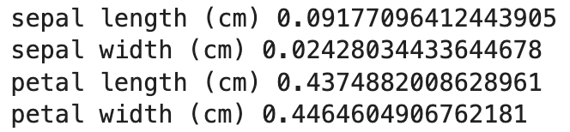
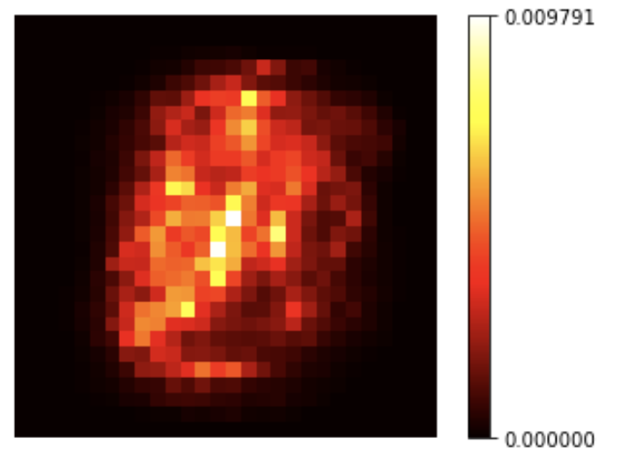
Feature importance
We can measure the relative importance of each feature by looking at how much the tree nodes that use that feature reduce impurity on average
across all trees in the forest
Consider the iris dataset
most important features are the petal length and width (>40%)
while sepal length and width are rather unimportant in comparison
We can try also to find the most important pixels on the MNIST dataset
Random Forests are very handy to get a quick understanding of what features matter
to perform feature selection

Slide 11
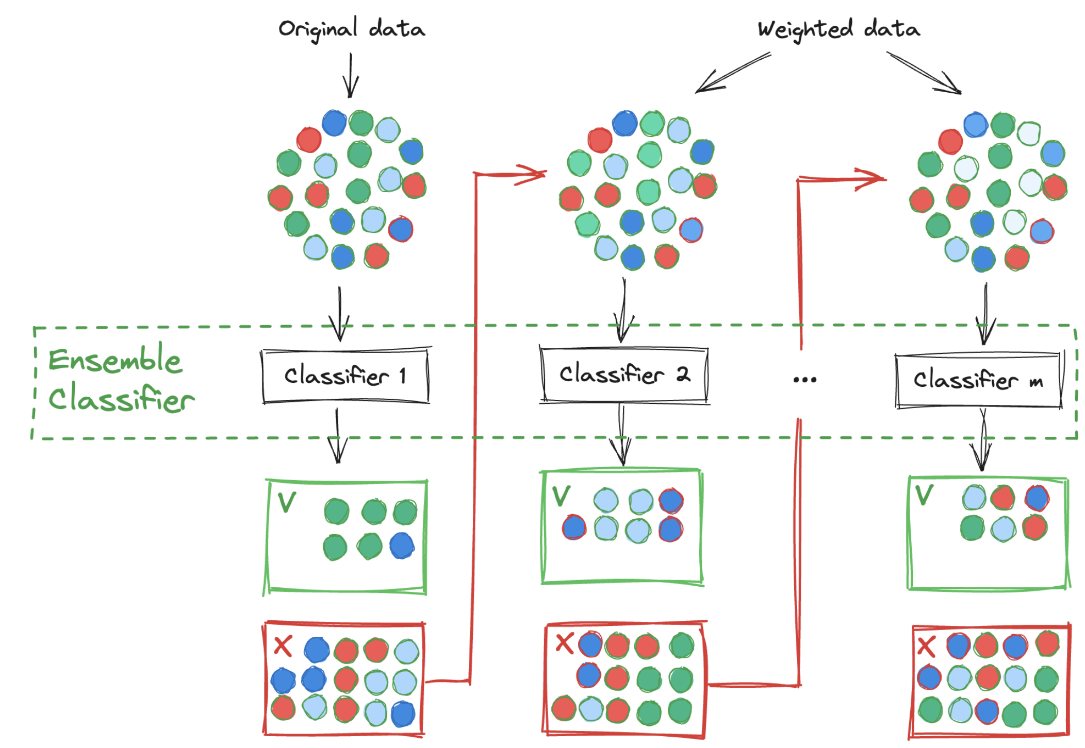
Adaptive Boosting (AdaBoost) (1)
Instead of combine weak models fitted independently, fit models iteratively
first train a base classifier and uses it to make predictions on the training set
increase the weight of misclassified instances
train a second classifier, using the updated weights, and again, make predictions, update the instance weights, and so on
at the end make predictions like bagging, except that predictors have different weights depending on their overall accuracy
Drawback: it cannot be parallelized; each predictor can only be trained after the previous predictor has been trained and evaluated
it does not scale as well as bagging

Slide 12
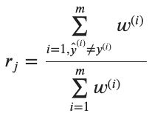



Adaptive Boosting (AdaBoost) (2)
Instance weight 𝑤^{(𝑖)} are initially set to 1/m (m training set size)
The weighted error rate of the predictor j is computes as
The predictor’s weight is then computed
where 𝜂 is the learning rate hyperparameter
the more accurate the predictor is, the higher its weight will be
if it is just guessing randomly, then its weight will be close to zero
if it is most often wrong (less accurate than random guessing), then its weight will be negative
Next, AdaBoost updates instance weights to boosts the misclassified instances
To make predictions, AdaBoost simply computes the predictions of all the predictors and weighs them:

Slide 13
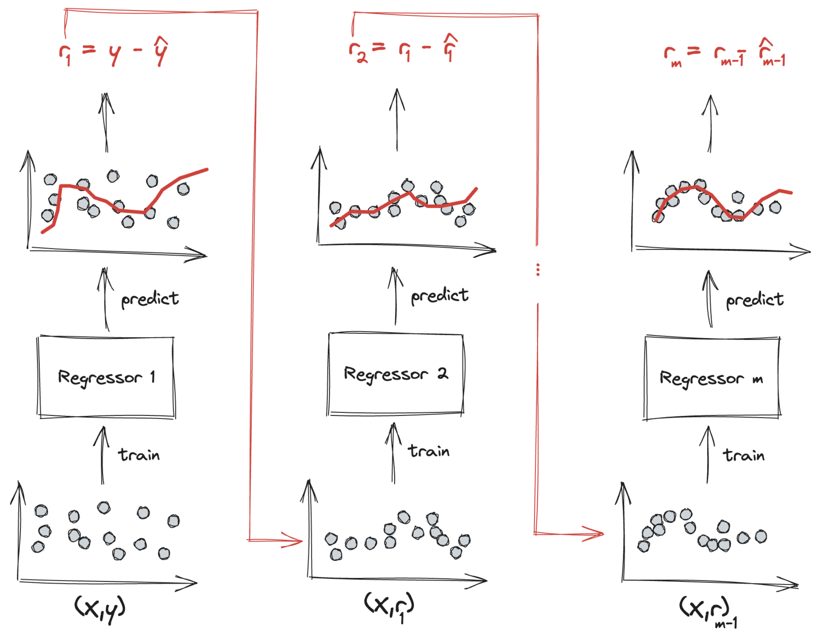
Gradient Boosting (1)
Instead of tweaking instance weights, we can fit new predictors to the residual errors
Consider a regression problem:
fit a regressor to the training set
train a second regressor on the residual errors made by the first one
train a third regressor on the residual errors made by the second, etc.
finally, we have an ensemble containing N regressors:
it makes predictions simply adding the predictions of all the regressors

Slide 14
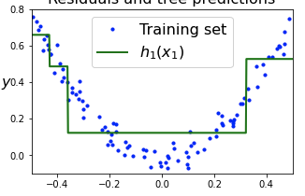
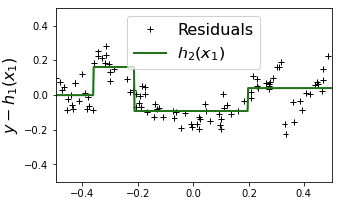
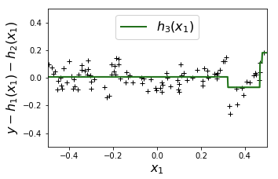
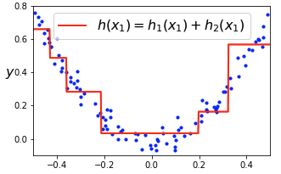
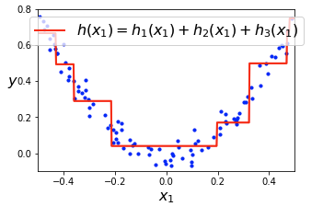
Gradient Boosting (2)
Example with a noisy quadratic training set
We can see that the ensemble’s predictions gradually get better as estimators are added to the ensemble

Slide 15
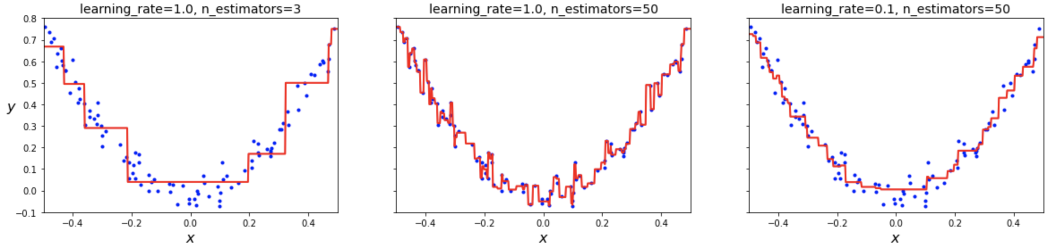
Shrinkage
Two hyperparameters:
number of estimators
shrinkage to scales the contribution of each estimator
if shrinkage is low, we need more estimator to fit the training set, but predictions will usually generalize better
regularization technique
Example: the first ensemble does not have enough trees to fit the training set, the second overfits, while the third seems good
To find the optimal number of estimators, we can use early stopping

Slide 16
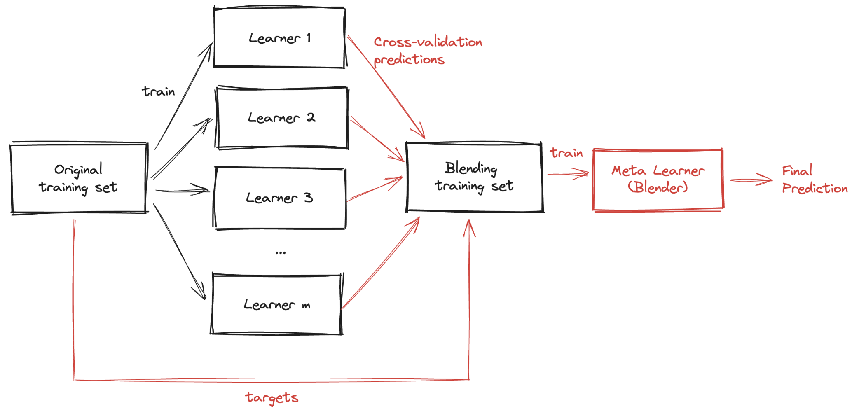
Stacking
Instead of using trivial functions (such as hard voting) to aggregate the predictions of all predictors in an ensemble, why don’t we train a model to perform this aggregation?

Slide 17
Exercise
1 - Load the MNIST dataset and split it into a training set, a validation set, and a test set. Then train various classifiers. Next, try to combine them into an ensemble that outperforms each individual classifier on the validation set, using soft or hard voting. Once you have found one, try it on the test set. How much better does it perform compared to the individual classifiers?
2 - Run the individual classifiers from the previous exercise to make predictions on the validation set and create a new training set with the resulting predictions: each training instance is a vector containing the set of predictions from all your classifiers for an image, and the target is the image’s class. Train a classifier on this new training set. We have just trained a blender, and together with the classifiers it forms a stacking ensemble! Now evaluate the ensemble on the test set. For each image in the test set, make predictions with all your classifiers, then feed the predictions to the blender to get the ensemble’s predictions. How does it compare to the voting classifier you trained earlier?

